Slide 1


Data Analysis For Optimizing User Engagement: App & Website Installations
Logambal J

Slide 2
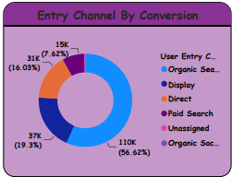
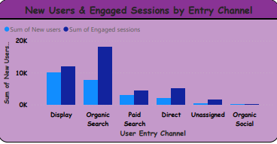
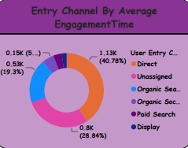
Channel Entry Analysis
Organic Search leads with a 56.62% conversion rate, significantly higher than Direct Search, which stands at only 4%. Therefore, prioritizing efforts on optimizing Organic Search further could yield better results.
Direct Search boasts the highest average engagement time, accounting for 40.78%, while Display ranks lowest with 2%. This indicates a need for refining engagement strategies, especially for Display channels, to increase interaction time.
Display attracts the highest number of new users (100k), while Organic Social lags with only 10 new users. However, Organic Search dominates in engaged sessions (18k), contrasting with Organic Social's minimal engagement (10 sessions).

Slide 3
Recommendations For Channel Entry Analysis
Allocate more resources towards enhancing Organic Search strategies to capitalize on its high conversion rate.
Implement measures to improve engagement on Display channels to increase the average engagement time.
Despite Display's success in attracting new users, focus on increasing engagement in Organic Social channels to align with the higher engagement seen in Organic Search.

Slide 4
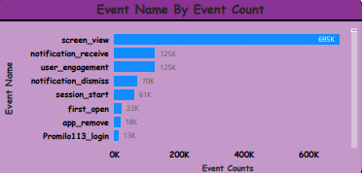
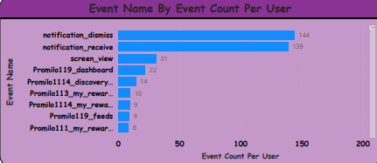
Event Analysis
Event Name "Screen View" has the highest event count, totaling 695K, while "My Interests Screen" has the lowest count with only 1 event. Additionally, an event named "Another Event Name Not Set" recorded zero events.
When considering event count per user, "Notification Dismiss" has the highest count with 95 events per user, while "My Interests Screen" has the lowest with only 1 event per user. "Another Event Name Not Set" recorded zero events per user.
"Notification Receive" achieved the highest number of conversions, totaling 95k, whereas "Promilo106 Campaign Interest" only recorded 20 conversions.

Slide 5
Recommendations For Event Analysis
Investigate further the significance of "Screen View" events and optimize strategies to leverage this high event count for user engagement and conversions.
Explore ways to enhance user interaction and engagement on the "My Interests Screen" to increase its event count per user and potentially drive conversions.
Analyze the events labeled "Another Event Name Not Set" to understand why they recorded zero events and consider refining tracking or addressing any issues causing this lack of data.
Allocate resources towards campaigns or strategies related to "Notification Receive" due to its significant impact on conversions, while also considering ways to improve performance for "Promilo106 Campaign Interest" to boost conversions further.

Slide 6
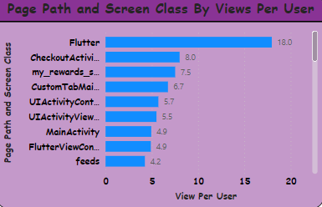
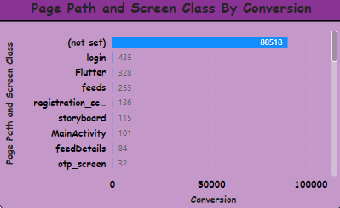
Pages and Screens Analysis
In Page Path and Screen Class by Views per User, Flutter has the highest number of viewers with 18.0 views per user, accounting for 14%, while UI Alert Controller has the lowest with only 1 view per user, representing a decrease of 7%.
In Page Path and Screen Class by Conversion, the category "Not Set" leads with 88,518 conversions, making up 98% of the total.
Conversely, PH Picker View Controller, SL Compose View Controller, Campaign Meeting, CAM Image Picker Camera View Controller, UI Alert Controller, Campaign Interest, Calculator One, UI Activity View Success Controller, UI Activity Content View Controller, Calculator Two, SF Authentication View Controller, My Profile Professional, Custom Tab Activity, SF Safari View Controller, and Checkout Activity all have zero conversions.

Slide 7
Recommendations For Page and Screen Analysis
Capitalize on the popularity of Flutter by optimizing content and features to further engage users and potentially drive conversions.
Investigate and address any issues or barriers preventing conversions in the mentioned categories, ensuring seamless user experiences and effective conversion funnels.
Consider reallocating resources or revising strategies for features and categories with low viewer or conversion rates to maximize overall performance.

Slide 8
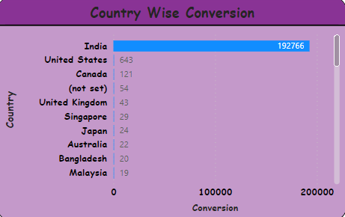
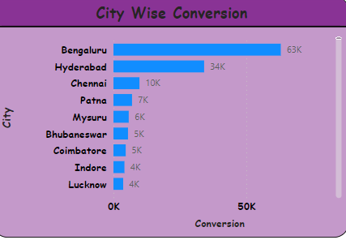
Country and City-Wise Analysis
In country-wise analysis, India has the highest number of conversions with approximately 192K, constituting 99%. Sri Lanka has a lower conversion rate at 0.33%, and Kenya shows zero conversions.
In city-wise conversion, Bengaluru stands out with the highest count at 63K. However, several other cities have low conversion counts, some even as low as 1.

Slide 9
Recommendations For Country and City-Wise Analysis
Focus on leveraging the high conversion rate in India by tailoring marketing strategies and content to the Indian audience.
Investigate the factors contributing to the low conversion rates in Sri Lanka and address them to potentially increase engagement and conversions.
Analyze the reasons behind the zero conversions in Kenya and explore ways to improve user engagement and conversion opportunities in that region.
In city-wise conversion, assess the performance of Bengaluru to identify successful strategies that can be applied to other cities with lower conversion counts.
Implement targeted marketing campaigns or features to boost engagement and conversions in cities with low conversion counts.

Slide 10
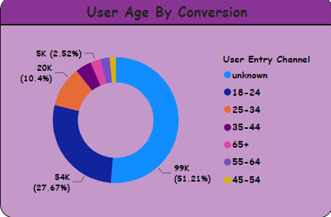
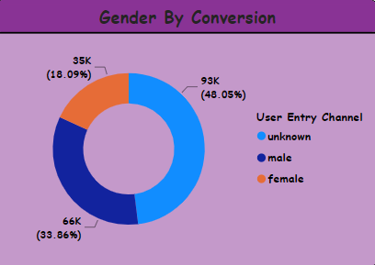
User Age and Gender Conversion Analysis
User age by conversion shows that the "Unknown" age category leads with 99k conversions, representing 51.21% of the total.
The second-highest conversion rate is among the 18-24 age group, with 66k conversions, accounting for 33.86%. The lowest conversion count is observed among the 45-54 age group, with only 3k conversions.
In gender-wise analysis, the "Unknown" category has the highest value, with 93k conversions, making up 48.05% of the total. The lowest conversion count is among females, with 35k conversions, representing 18.09%.

Slide 11
Recommendations For Age and Gender Conversion Analysis
Since the "Unknown" category holds significant value in both age and gender analyses, providing an option for users to specify or update their age and gender information can lead to more useful insights and targeted marketing strategies.
Implement features or prompts within the platform to encourage users to provide their age and gender information, ensuring data accuracy and enhancing the effectiveness of marketing campaigns.
Continuously monitor and analyze user demographics to identify trends and adjust strategies accordingly to maximize conversions and engagement.

Slide 12
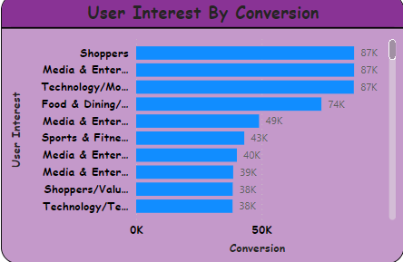
User Interest Analysis
User interest by conversion and users indicates that the "Shoppers" category leads with 87K conversions and a high number of users. Conversely, the "Sports & Fitness/Sports Fans/Fans of American" category has significantly lower conversions, with only 20.
Within specific interest categories, "Shoppers/Shoppers by Store Type" has the highest average engagement time, recorded at 3417, while "Media & Entertainment/Movie Lovers/Romance & Drama Movie Fans" has the lowest engagement time, at 54.

Slide 13
Recommendations For User Interest Analysis
Allocate resources and marketing efforts towards targeting users interested in shopping-related content, as it demonstrates high conversion rates and user engagement.
Consider revising marketing strategies or introducing new campaigns to boost engagement and conversions among users interested in sports and fitness, as well as fans of American sports.
Analyze the factors contributing to the high engagement time in the "Shoppers/Shoppers by Store Type" category and leverage this information to optimize engagement strategies for other interest categories.
Explore ways to increase engagement and retain users interested in media and entertainment, particularly those focused on romance and drama movies, to enhance overall conversion rates and user satisfaction.

Slide 14
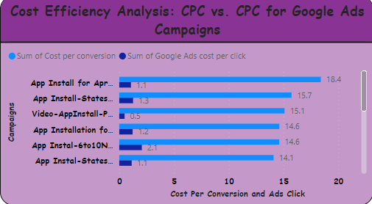
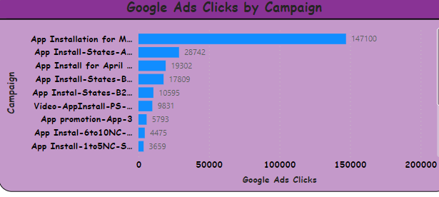
Google Ads Campaign Analysis
In the cost efficiency analysis, "Cost per Conversion App Installed for April" ranks first with 18.4, while "Cost per App Installation May" stands last with 3.3.
"Cost per Ads Click App Installed 1-5NC" is observed to be 2.1, indicating the cost per ads click for app installation within the 1-5NC range.
The lowest cost is associated with "Video App Install with PS Install" at 0.5, reflecting the lowest cost for installing apps through video ads with PS installation.
Google's Ads Clicks by Campaign reveal that "App Installed by Shaid" accumulated the highest number of clicks, reaching 147,100. Conversely, the lowest clicks were attributed to "App Installed by May 2022".

Slide 15
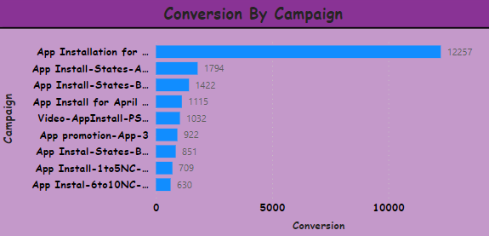
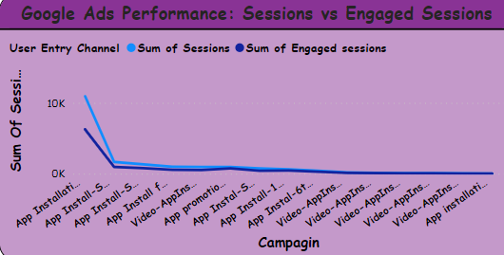
"Conversion by Campaign App Installed for May" stands out significantly with 12,257 conversions, indicating its effectiveness in driving app installations during May. Conversely, "App Installed by May 2022" only resulted in 5 conversions, suggesting a much lower performance.
Google Ads performance in terms of sessions and engaged sessions reveals that "App Installed by May" contributed 11k sessions and 6k engaged sessions, indicating a substantial level of user activity. In contrast, "App Installed by May 2022" had the lowest performance with only 5 sessions and engaged sessions.

Slide 16
Recommendations For Google Ads Analysis
Focus efforts on optimizing campaigns similar to "Cost per Conversion App Installed for April" to maintain or improve cost efficiency in app installations.
Investigate and address any inefficiencies in campaigns associated with "Cost per App Installation May" to reduce costs and improve performance.
Consider reallocating budget towards campaigns with lower costs per ads click, such as "Cost per Ads Click App Installed 1-5NC", to maximize return on investment.
Evaluate the effectiveness of video ads with PS installation, as seen in "Video App Install with PS Install", and explore opportunities to leverage this cost-efficient channel for app installations.
Analyze the success factors behind campaigns like "App Installed by Shaid" to identify strategies for improving click rates and conversions, while also exploring ways to optimize campaigns with lower click rates, such as "App Installed by May 2022".

Slide 17
Recommendations For Google Ads Analysis
Allocate more resources towards campaigns similar to "Conversion by Campaign App Installed for May" to capitalize on their effectiveness in driving app installations.
Evaluate and optimize Google Ads campaigns to enhance session and engaged session metrics, focusing on channels that demonstrate higher user activity such as "App Installed by May".
Investigate the factors contributing to the low performance of "App Installed by May 2022" and consider revising strategies or reallocating resources to more effective campaigns.
Continuously monitor campaign performance and user engagement metrics to identify trends and make informed decisions to improve overall app installation and user interaction rates.

Slide 18
Thank You
Logambal J

